Slide 1
Eaton
OUD LDAP Support On Demand
January 2024

Slide 2



Our Understanding
Background
Scope
Key Benefits
Eaton is looking to upgrade their LDAP directory from ODSEE to OUD.
KPMG Consulting is going to help with the upgrade.
Eaton is considering external managed services to support and complete management for the LDAP OUD environment
Supporting OUD server patching and upgrade activities
Server monitoring and management (includes OUD stack status monitoring, periodic server restarts, managing data replication between 2 or more directory server instances)
Support of standard admin tasks (like data backup, data clean-up etc.)
Incident management (e.g., handling data replication/sync issues in upstream/downstream apps, user/group/role data issues) and service requests (like user and group management operations using command line interface or supported LDAP browser interface)
Reporting and minor technical enhancements
Ongoing maintenance and operation of the directory solution will enable Eaton team to focus on strategic activities
Access to a skilled KPMG team to support both technical and strategic advisory activities
Reduced cost of internal staffing.
Increased business and operational efficiencies
Seamless transition from ODSEE to OUD operations considering KPMG’s proven support history with similar requirements

Slide 3
Draft for discussion
OUD / LDAP Operations
Scope Area | Description
OUD Stack Monitoring | 24x7 monitoring of the health of the directory solution stack (e.g. OUD) Directory platform health monitoring but not limited to server status, replication status, proxy services, SSL certificate expiry Target application connectivity error identification Monitoring of application up-time | Monitoring and reporting of performance
Patch Management | Identification of interim product patches Communication for critical security patches released by vendor will be monitored Identification of product feature patches to enhance directory solution capabilities Validation test post-installation to verify operations | Minor configuration changes to the OUD platform Configure application log rotation via product capability or custom scripts SSL Certificate monitoring and updates Documentation updates Log file management and rotation
Incident / Service Request Management | Logging of all incidents into incident tracking system Triage and prioritization of incidents Resolution of incidents within LDAP Platform resulting from monitoring or failures Resolution of incidents within LDAP Platform resulting from end-user ticket Escalation of incidents outside the LDAP Platform Restoration of service | Workaround during service restoration Root cause analysis for critical or business impacting incidents Handling data replication/sync issues in upstream/downstream apps Handling user/group/role data issues User and group management operations using command line interface or supported LDAP browser interface Raising and managing of service requests with vendor Participation in resolution calls for critical or business impacting incidents

Slide 4
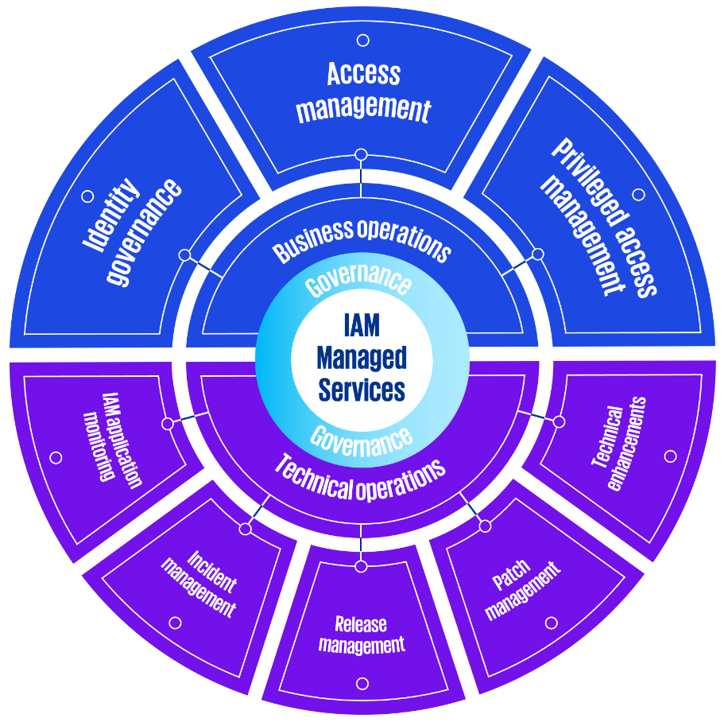

KPMG Managed IAM Services overview
IAM touches every aspect of an organization and is the cornerstone of security. Done right, an IAM solution must continuously evolve to improve efficiencies, increase usability, and reduce risk. Our managed services for IAM focuses on delivering outcome-based results for business and technical operations that help build resilience and trust.
We provide a single point of contact for all aspects of your IAM program:
IAM Business Operations
Continuous management and tracking of business processes, such as executing access review campaigns for SOX or access management for adding/removing access to applications.
IAM Technical Operations
Daily management of the health of the IAM solution such as application monitoring, data feed integrations, application administration and patching, and incident management.
Potential benefits
Continuous improvement and modernization to improve security, reduce risk and enhance user experience
Increased business and operational efficiencies
Regulatory compliance support
24/7 access to a skilled KPMG team to mitigate disruptions
Support from a world leader in IAM implementation and award-winning alliances with all major IAM technology providers

Slide 5
KPMG Managed IAM Services capabilities
IAM application monitoring
24x7 monitoring of IAM environment to validate health and functionality of the solution
Governance
Reporting
Change management
Quarterly business reviews
Assessments / healthchecks
Release
management
Patch
management
Technical
enhancements
Incident
management
IAM application
monitoring
Identity governance
Access management
Privileged access management
Incident management
Triage, analysis, and troubleshooting of incidents, whether detected manually or through automated tools
Governance
Identity governance
Technical operations
App onboarding
Manual provisioning
Access certification campaigns
SoD remediation
Role/Entitlement management
Custom IGA reporting
Business operations
Governance
Release management
Disciplined approach to testing and deployment into production of all changes within the environment for continuous evolution of the IAM solution
Governance
IAM Managed Services
Access management
Application onboarding
Policy management
User lifecycle management
MFA management
AM specific reporting
Federated access management
Scope and claim management
Directory management
Patch management
Analysis, testing, and deployment of vendor related patches and hotfixes
Privileged access management
Technical enhancements
Continuous administration, configuration, and enhancements of the IAM solution, including design, testing, and production deployment
Governance
Asset onboarding
Account management
Safe management
Component management
Platform management
Privileged access certifications
Custom PAM reporting
Business operations
Technical operations
Notes:
Designed to achieve faster, measurable and scalable outcomes for your IAM programs, our service delivers a quantifiable reduction of cyber security risks for you, while demonstrating auditable and sustainable outcomes to regulators.
Business operations
Day-to-day management and tracking of your business processes, including access review campaigns.
IAM application operations
Peace of mind from trusted daily and continuous management of the IAM solution’s health.
IAM application enhancements
Immediate and ongoing improvements to the functionality and capabilities of your IAM solution.

Slide 6
KPMG Managed IAM Services
With Managed IAM Services, KPMG can provide a thorough approach to developing an IAM program, from strategy and assessments, to implementation and management of the day-to-day IAM operations.
Strategize
Implement
Operate and evolve
Strategy Roadmap
Current State Assessment
Future State Modelling
Target Operating Model
Capability & Maturity Assessment
Product & Vendor Evaluation
Implementation Planning & Roadmap
Infrastructure Health check
Application Prioritization
Requirements Modelling
Architecture Blueprint
Implementation Design
Use Case Modelling
Entitlements & Role Modelling
Phased Rollout
Application Onboarding
Technology Modernization
Platform Migration
Product Integration
Knowledge Transfer
Business Enablement
Application Onboarding
Access Certification Campaigns
IAM Application Monitoring
Incident Management
Patch Management & Software Updates
Application Administration
Role Lifecycle Management
Access Request Management
Orphan Account Management
Access Management Operations
IAM Solution Enhancements
KPI/KRI Reporting

Slide 7
Managed IAM Services – governance model
Frequency and purpose
Stakeholders
Quarterly
Align business strategy with Cyber Managed Services
Guide execution of IAM services
Continuous improvement and innovation
Review annual strategic themes, priorities and budget
Support adequate risk mitigation and controls
Program sponsorship and scorecard review
Client: IAM Executive leadership, IAM Sponsor, Project Lead
KPMG: Lead Partners, Customer Success Manager, Delivery Leads
Strategic
Monthly
Present management reporting
Conduct business review of service level performance
Review issues log and risk mitigation
Review and approve release plans, priorities and change requests
Forecasting and demand management
Client : IAM Sponsor, Project Lead
KPMG: Lead Partners, Customer Success Manager, Delivery Leads, Technical Leads
Tactical
Weekly / as needed
Manage operations and escalations
Review development velocity and backlog
Review weekly stats
Client: Project Lead
KPMG: Delivery Leads, Technical Leads
Operational

Slide 8

Managed IAM Services – operating model
Client
KPMG Delivery
Platform Oversight
Business Operations
Service delivery coordination
Solution enhancement and support
KPMG Governance & Reporting
Technology Management
Technical Operations
Day-to-day management of IAM technical and business operations
Application Governance
Enhancements
Application onboarding & Integration
ServiceNow ticketing | Jira | IAM Platform Monitoring
KPMG delivery resources
KPMG Client Success Manager
KPMG onshore technical lead
KPMG offshore delivery lead
KPMG support specialists
(offshore)
Service Delivery & Quality Standards
Key Performance Indicator Monitoring
Service Management Reporting

Slide 9
Some or all of the services described herein may not be permissible for KPMG audit clients and their affiliates or related entities.
kpmg.com/socialmedia
The information contained herein is of a general nature and is not intended to address the circumstances of any particular individual or entity. Although we endeavor to provide accurate and timely information, there can be no guarantee that such information is accurate as of the date it is received or that it will continue to be accurate in the future. No one should act upon such information without appropriate professional advice after a thorough examination of the particular situation.
© 2024 KPMG LLP, a Delaware limited liability partnership and a member firm of the KPMG global organization of independent member firms affiliated with KPMG International Limited, a private English company limited by guarantee. All rights reserved.
The KPMG name and logo are trademarks used under license by the independent member firms of the KPMG global organization.

